Slide 1
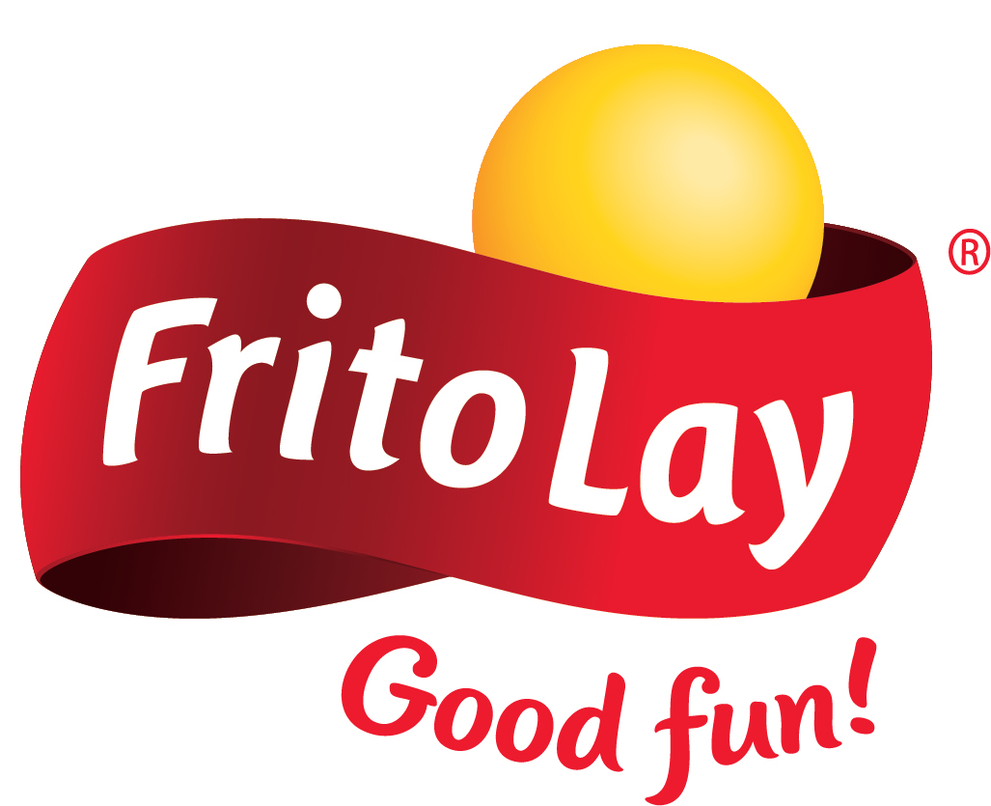
DDSAnalytics PRESENTS: FRITO LAYS ATTRITION ANALYSIS
In a world that can be very unpredictable, Frito Lay is looking into predicting employee turnover.
Introducing the Ultimate Attrition Plan:
Stay Frito Lay 2021
Designed to make the most of the attrition at Frito Lay.

Slide 2
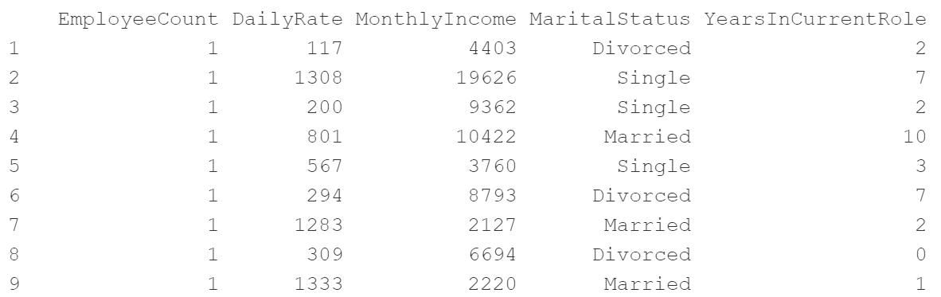
Discovery
Case Study 2.csv Sample
Exploratory Data Analysis
Given the dataset shown, the employee dataset
contained 870 unique observations with 36 categories. An exploratory data analysis was performed to find the top contributing factors to attrition and visual the attrition data .
Models
Summary

Slide 3
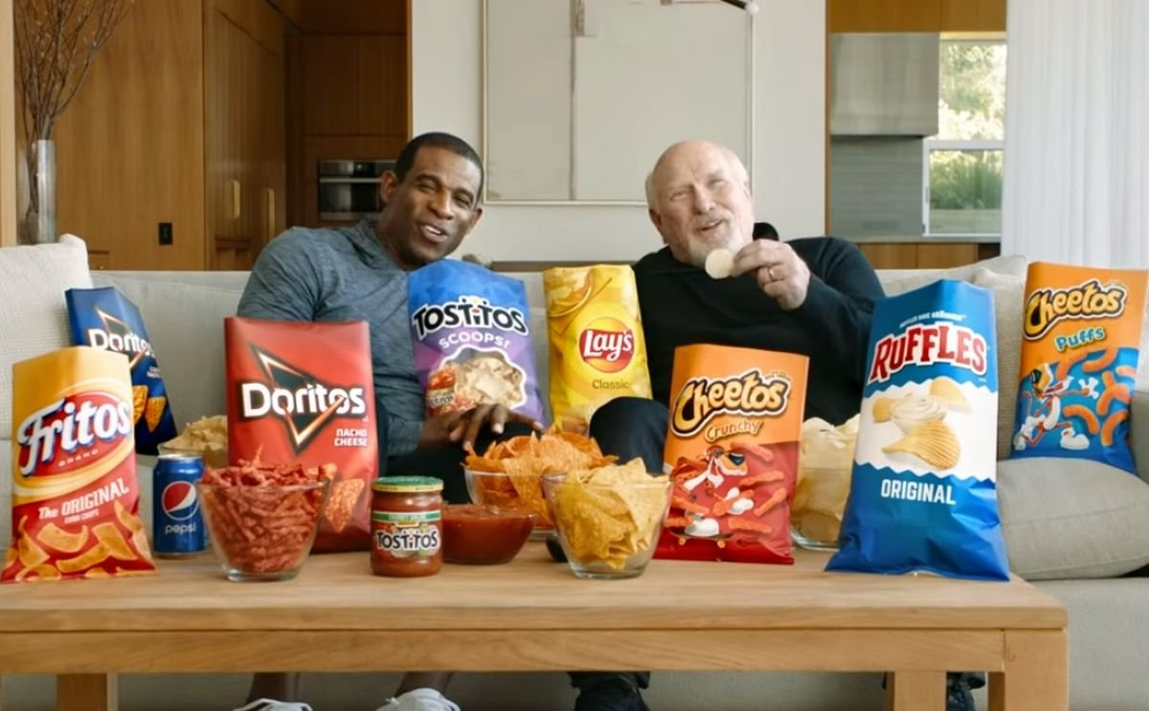
EXPLORATORY DATA ANALYSIS
Exploring the employee data set

Slide 4
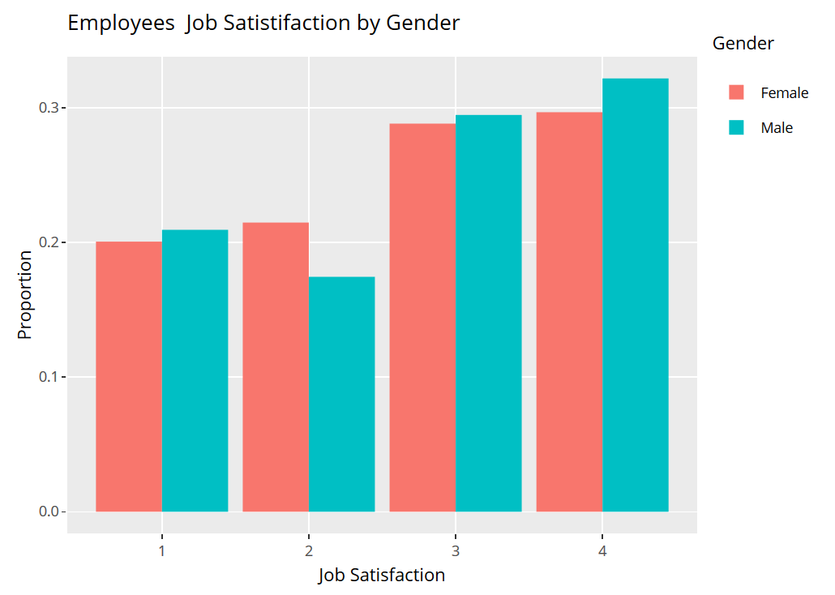
Job Satisfaction By Gender
Analysis
32% of men high satisfied with their jobs, while 21% are highly unsatisfied.
30% of women are highly satisfied with their jobs, while 20% are highly unsatisfied.
Both genders are about equal in every job satisfaction level.
Notes:
Union Jack is produced by Firestone Walker Brewing Company in Paso Robles, California. It is a balanced American IPA that should leave you tingling from the alcohol and bitterness!

Slide 5
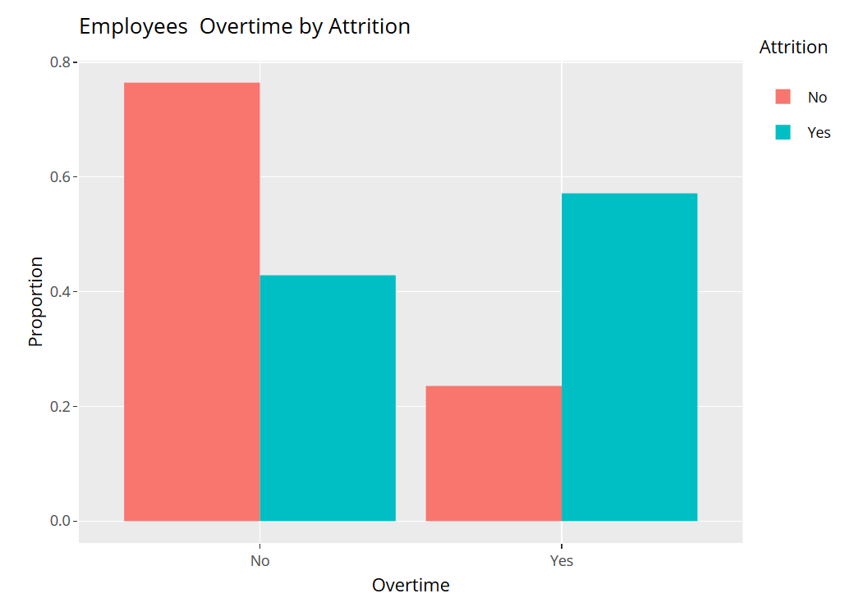
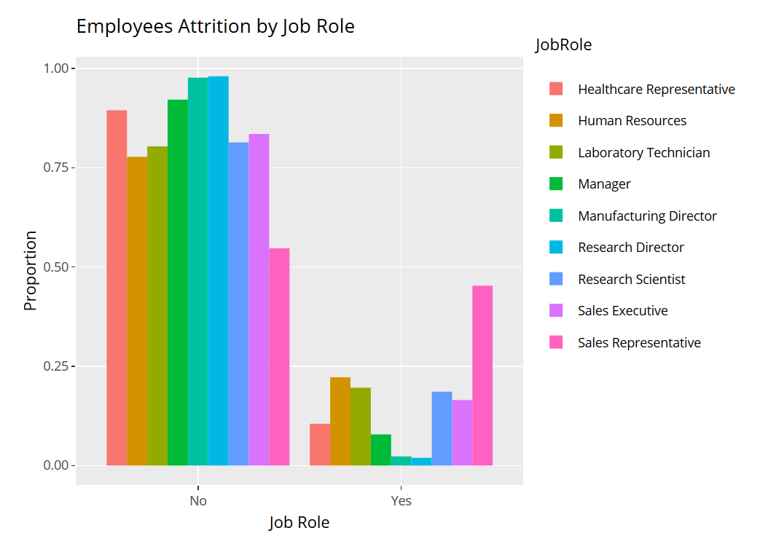
Attrition By Overtime & Job Role
Analysis
57% of employees that do overtime have a higher attrition rate.
24% of employees that do not do overtime show attrition issues.
Sales representatives have a 45% attrition rate.
Management roles have about a 20% attrition rate each.
Notes:
Union Jack is produced by Firestone Walker Brewing Company in Paso Robles, California. It is a balanced American IPA that should leave you tingling from the alcohol and bitterness!

Slide 6
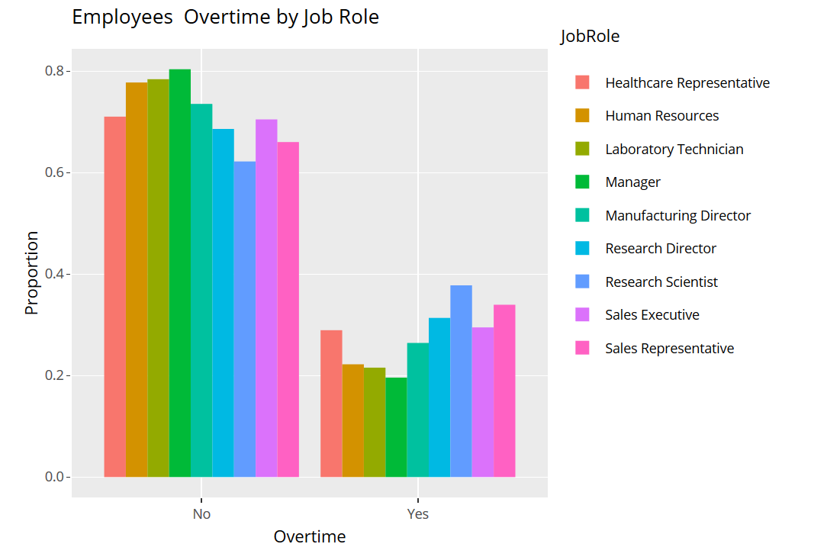
Job Role By Overtime
Analysis
Sales representatives and research scientists are 72% of the population that does overtime.
Notes:
Union Jack is produced by Firestone Walker Brewing Company in Paso Robles, California. It is a balanced American IPA that should leave you tingling from the alcohol and bitterness!

Slide 7
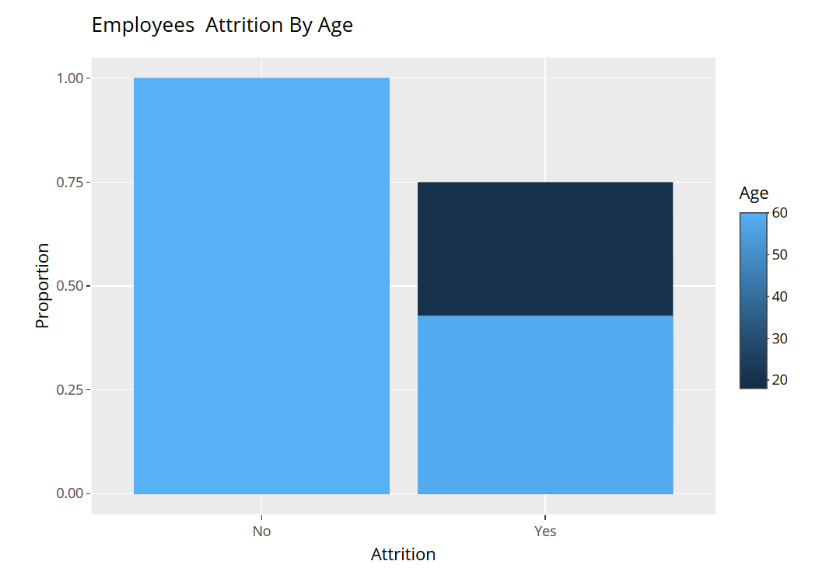
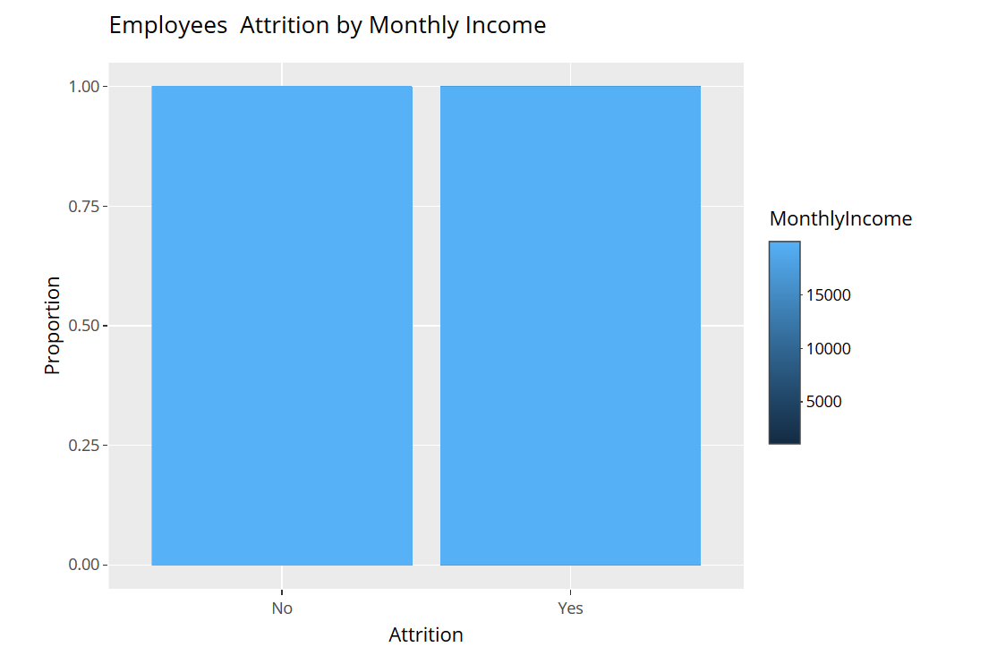
Attrition By Age & Monthly Income
Analysis
Employees ages 25 to 35 have a higher attrition rate.
Employees making around $2,500 monthly have a higher attrition rate.
Notes:
Union Jack is produced by Firestone Walker Brewing Company in Paso Robles, California. It is a balanced American IPA that should leave you tingling from the alcohol and bitterness!

Slide 8
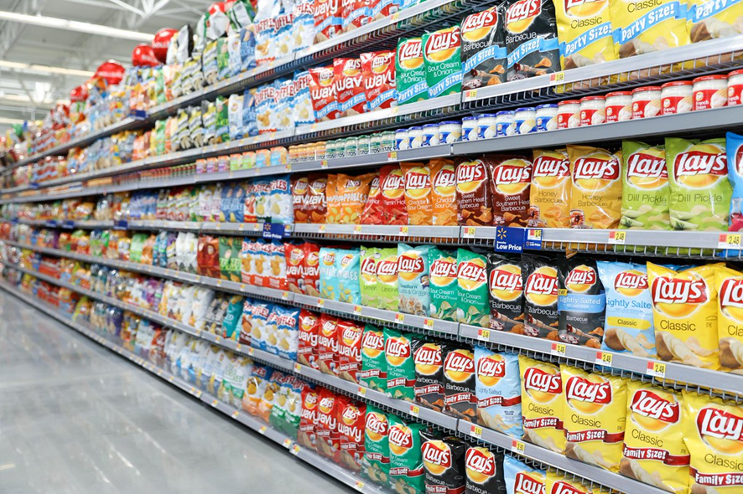
Modeling
Using models to predict attrition

Slide 9
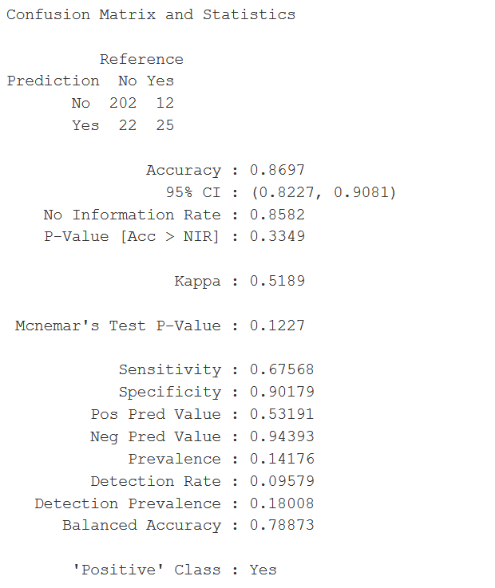

Modeling Using Naïve Bayes
86.97% Accuracy
67.75% Sensitivity
90.18% Specificity
3rd Floor

Slide 10
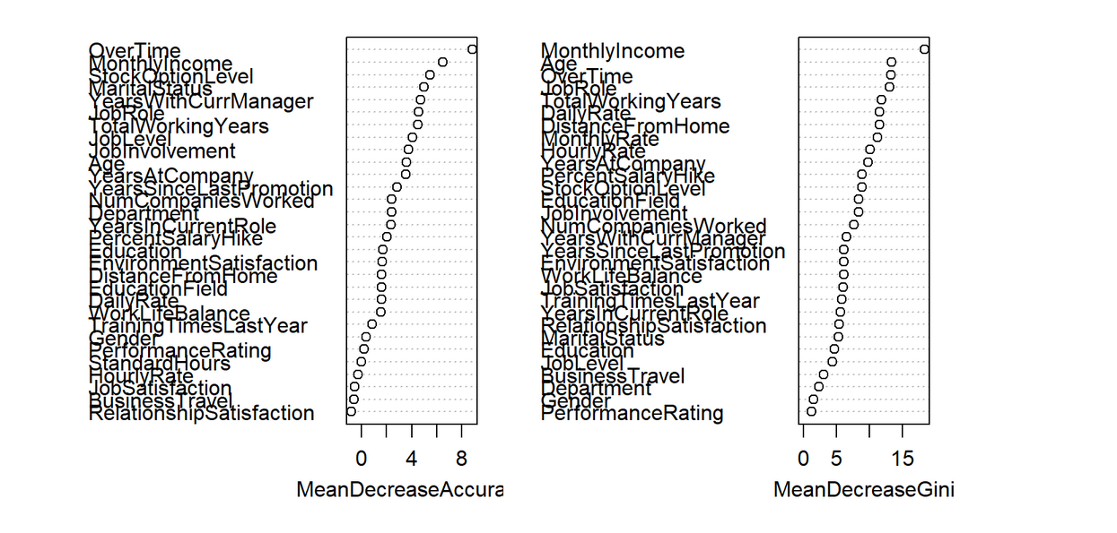
Determining Attrition Factors & RMSE of Monthly Income
Top 3 Attrition Factors
Monthly Income
Age
Overtime
RSME of Monthly Income: $1,057
3rd Floor

Slide 11
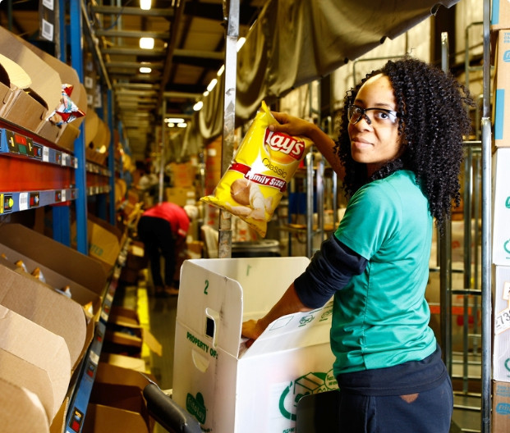
Summary
Next steps for attrition moving forward

Slide 12
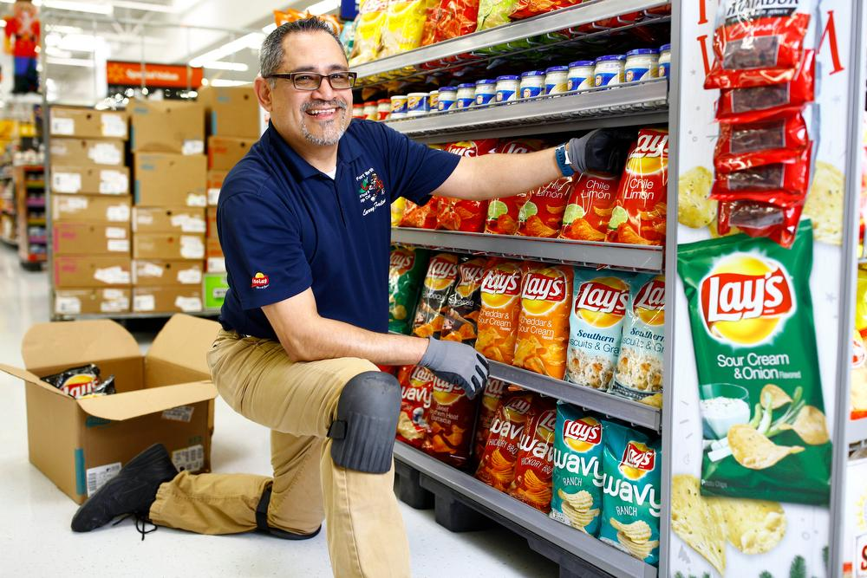
DDSAnalytics Presents ‘Stay Frito Lay 2021’
To achieve better attrition rates at Frito Lay, you should focus on Monthly Income, Age and Overtime.
Install Program to automatically promote or raise salaries
Create a program to ensure younger employees thrive
Raise overtime pay or lower the amount of overtime worked

Slide 13
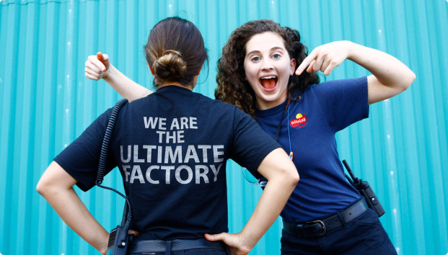
Thank You
For more information contact Domicia Herring at
dherring@ddsanalytics.com

